Slide 1

TASK 3 • PHASE 2
PAWSITIVE PET
ACADEMY
INSERT OFFICIAL
ACADEMY LOGO
Website and mobile application design presentation
Group members: KEAGILE MAKHAFOLA ST10506576
GORATA MAGOGODI ST10520088
MANAGA MASHUDU ST10510345
Course / Module: [XHAW5112] | Date: [10 N0VEMBER 2026]
Learn • Care • Train • Grow

Slide 2
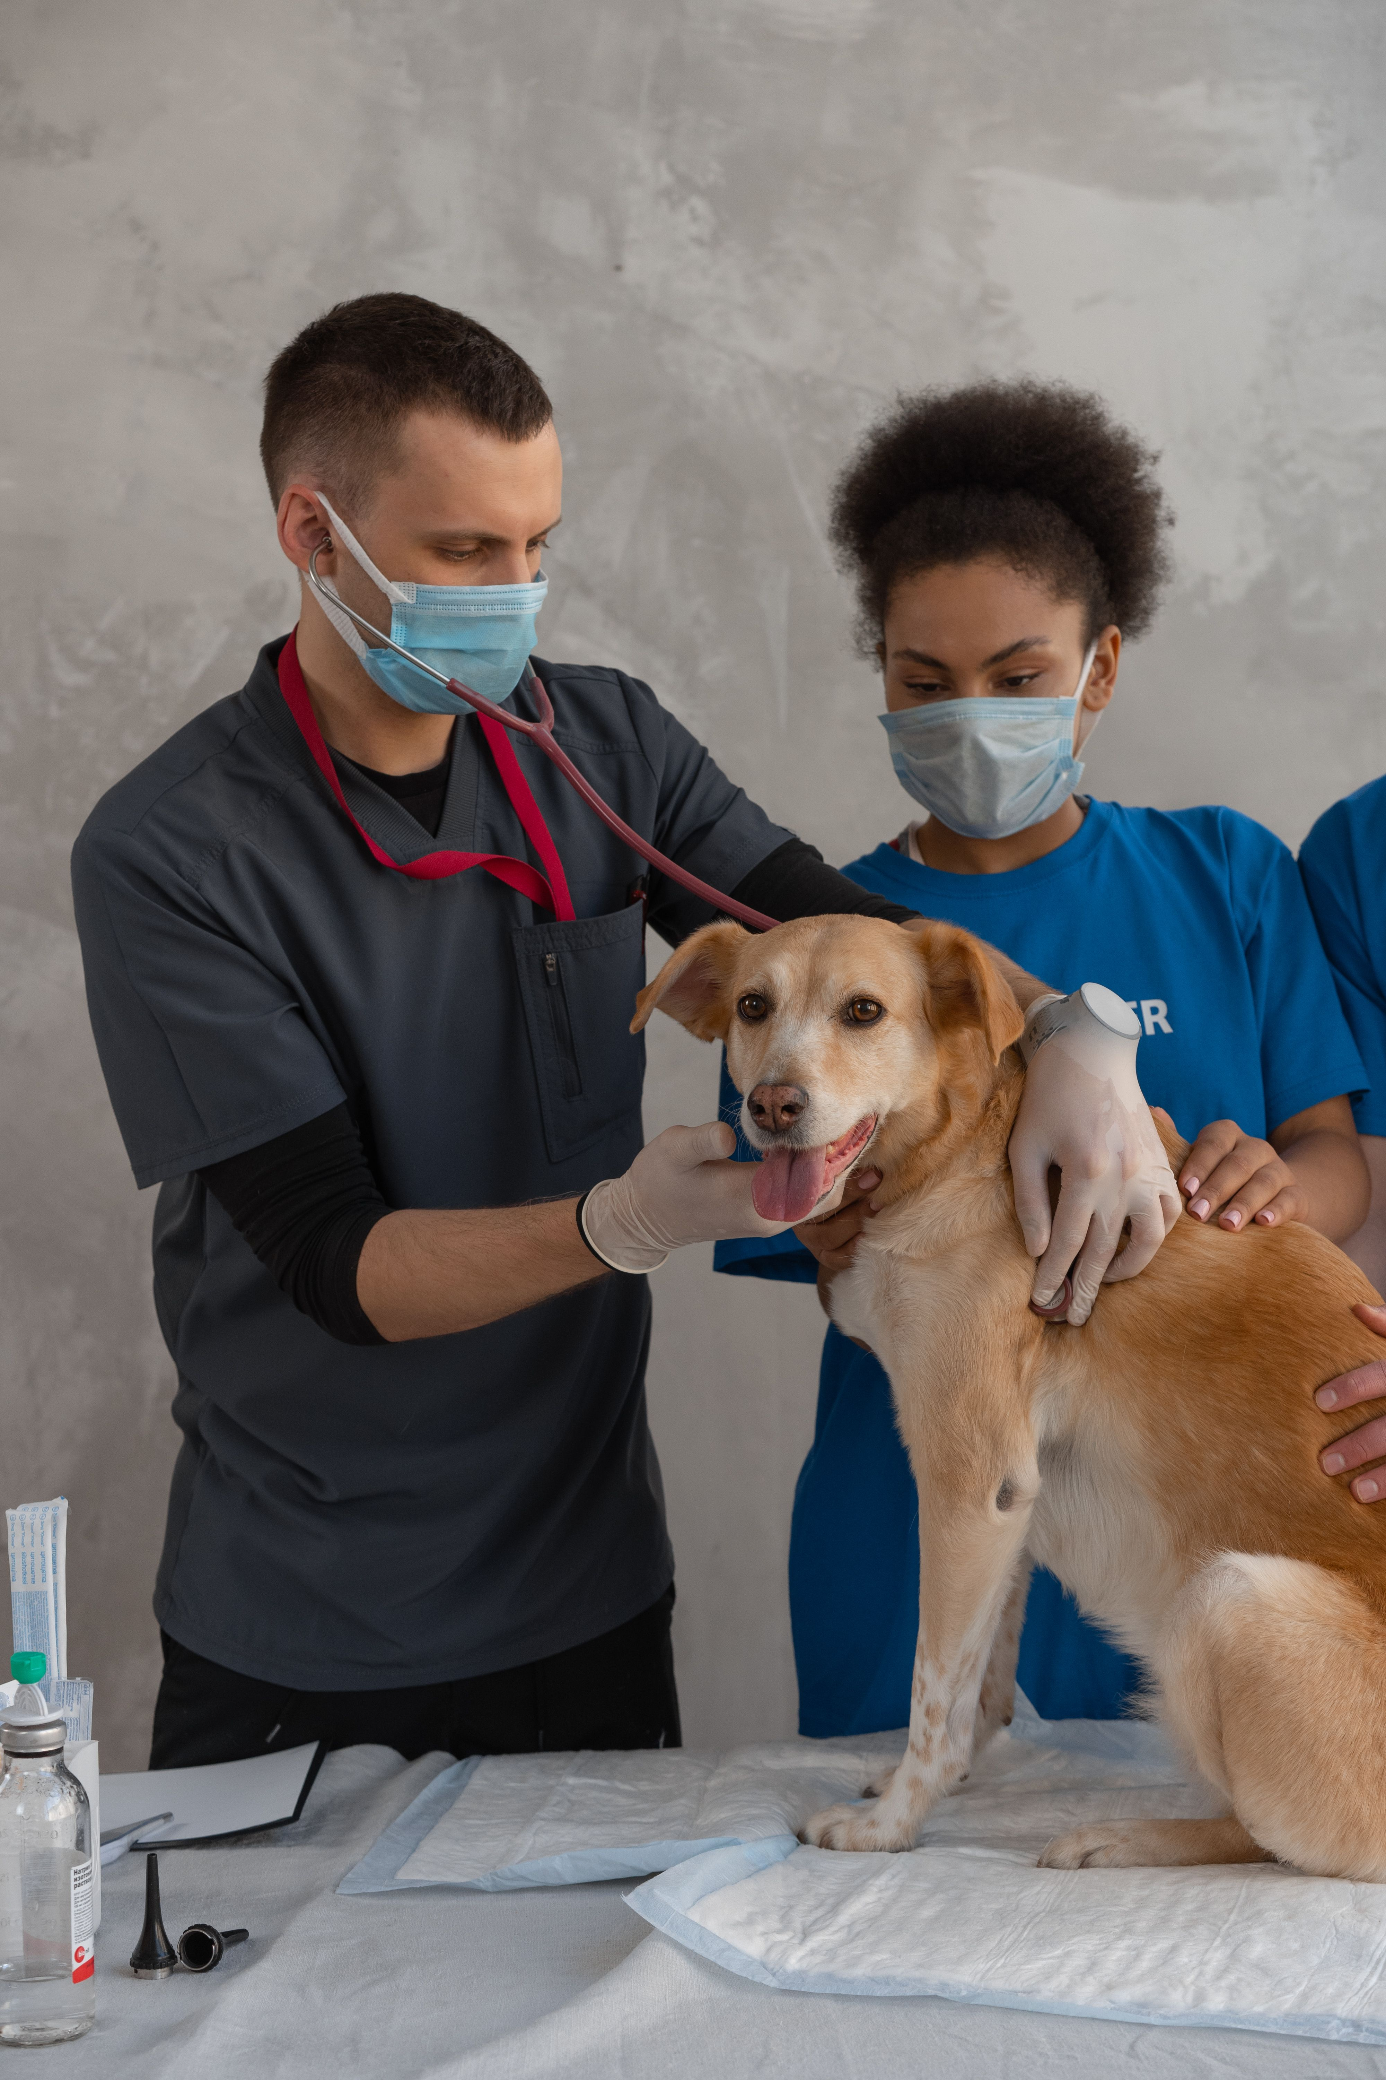
Project overview
A connected digital experience for pet-care education
About the academy
Project purpose
Platforms
Pawsitive Pet Academy is an educational concept focused on pet care, dog training, grooming and animal behaviour. The project background states that the academy was established in 2023 in Durban, South Africa and the client is Sarah Smith she is the owner and founder.
Create clear digital platforms where visitors can discover courses, understand fees, register and access learning information.
A website concept and a mobile application concept, designed around a consistent visual identity.
Design goals
ADD PROJECT / PET-CARE IMAGE
• Make information easy to find
• Present courses and prices clearly
• Support a simple registration journey
• Keep website and mobile screens consistent
PAWSITIVE PET ACADEMY | TASK 3 PHASE 2
2

Slide 3
Target users and their needs
Designing for people interested in learning responsible pet care
Prospective learners
Current learners
Visitors / pet owners
Need to compare courses, understand course content and see costs before registering.
Need to view enrolled courses, check progress and find support.
Need accessible information about the academy, its services and how to make an enquiry.
Key design response: simple navigation, readable content, recognisable buttons, relevant pet imagery and consistent page structure.
PAWSITIVE PET ACADEMY | TASK 3 PHASE 2
3

Slide 4
Brand identity and visual choices
A calm, welcoming palette inspired by care, trust and nature
INSERT OFFICIAL
PAWSITIVE LOGO
Colour palette
Deep Teal
#145A63
Soft Green
#8FA88A
Warm Cream
#F7F1E3
White
#FFFFFF
Typography: Poppins for headings and Inter for body text (or the closest available Figma alternatives).
Imagery: friendly photographs showing dogs, cats, grooming, training and animal care.
PAWSITIVE PET ACADEMY | TASK 3 PHASE 2
4

Slide 5
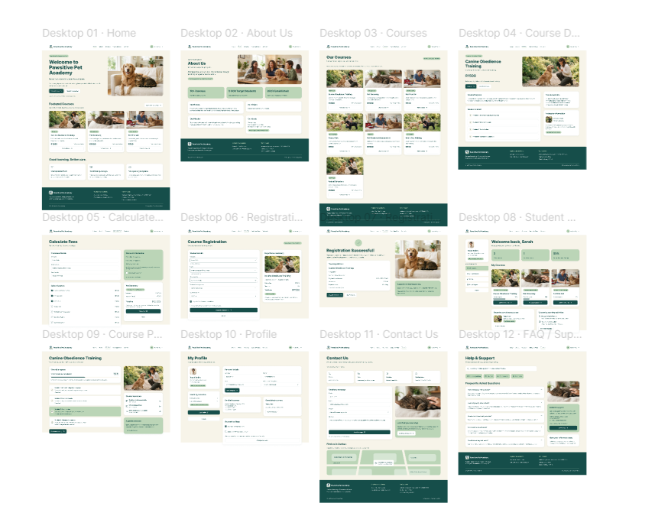
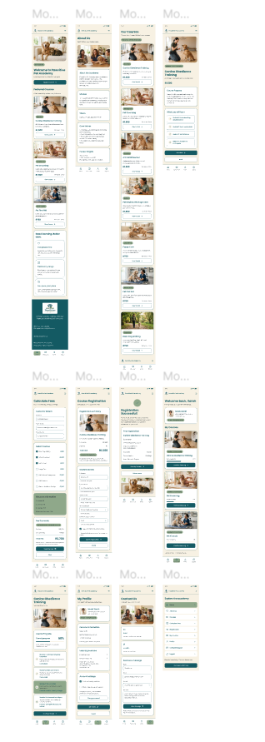
Wireframes and layout planning
Wireframes map content and navigation before visual styling
INSERT WEBSITE WIREFRAME
SCREENSHOT
INSERT MOBILE WIREFRAME
SCREENSHOT
Website: show page structure, navigation, content areas and footer.
Mobile: show compact layouts, touch-friendly controls and screen flow.
PAWSITIVE PET ACADEMY | TASK 3 PHASE 2
5

Slide 6
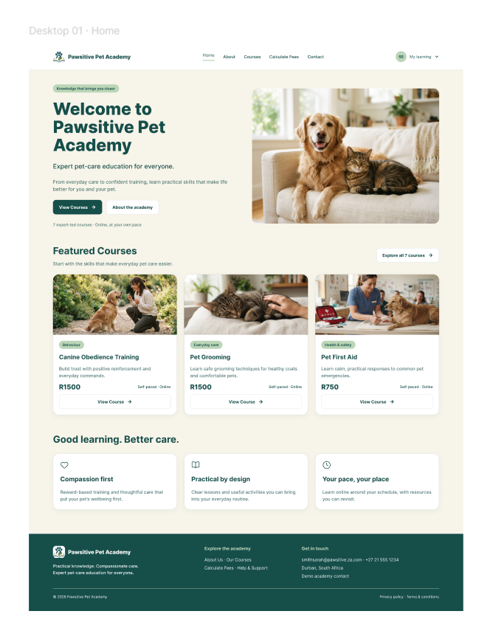
Website design
Desktop pages designed for clear browsing and course discovery
INSERT WEBSITE HOME PAGE SCREENSHOT
Home
Introduces the academy and guides visitors to courses.
Courses and fees
Presents course descriptions, prices and discount information.
About and contact
Builds trust and makes enquiries easier.
PAWSITIVE PET ACADEMY | TASK 3 PHASE 2
6

Slide 7
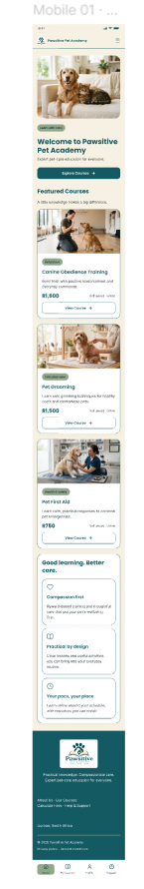
Mobile application design
12 screens supporting the learner journey
01 Home
02 About Us
03 Courses
04 Course Details
05 Calculate Fees
06 Registration
07 Registration Successful
08 My Courses
09 Course Progress
10 Profile
11 Contact / Support
12 Mobile Menu
PAWSITIVE PET ACADEMY | TASK 3 PHASE 2
7

Slide 8
Key features and user journey
From discovering a course to tracking learning progress
1
2
3
4
5
6
Discover
Explore
Plan
Join
Learn
Get help
Home / About
Courses / Details
Fees calculator
Registration
My Courses / Progress
Contact / Support
Website interactions
Mobile interactions
Navigation links, course detail links, enquiry and registration forms.
Screen navigation, fee calculation, learner course list and progress views.
PAWSITIVE PET ACADEMY | TASK 3 PHASE 2
8

Slide 9
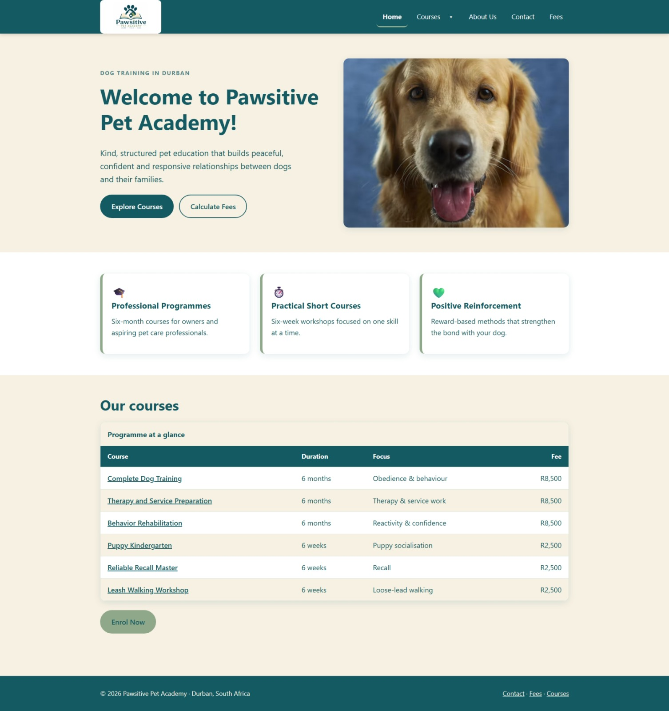
Demonstration and presentation
Introduce the live website and mobile prototype
INSERT WEBSITE DEMO
SCREENSHOT
INSERT MOBILE PROTOTYPE
SCREENSHOT
Website link
Prototype link
[https://github.com/keagile-M/WILL-WEBSITE-GROUP-9]
[https://www.figma.com/design/W63uoNy8ry1NeOBarRgiHZ/Untitled?node-id=0-1&p=f&t=BB89npbvIoibSXRV-0]
YouTube presentation (Unlisted): [https://youtube.com/shorts/sCF-H9lzkuo?si=FPo_sdzIHw-aBape]
PAWSITIVE PET ACADEMY | TASK 3 PHASE 2
9

Slide 10
Group presentation and contributions
Replace placeholders with your group's actual information
Presentation roles
Group responsibilities
Presenter 1: [KEAGILE MAKHAFOLA]
Presenter 2: [MASHUDU MANAGA]
Presenter 3: [GORATA MAGOGODI]
Design and wireframes: [MANAGA MASHUDU]
Website development:[KEAGILE MAKHAFOLA]
Mobile application: [GORATA MOGOGODI]
PAWSITIVE PET ACADEMY | TASK 3 PHASE 2
10

Slide 11
Conclusion
A consistent digital identity across website and mobile
The Pawsitive Pet Academy project brings together a website and mobile application concept to help users discover pet-care courses, understand fees, register and access learner information.
Consistent branding
User-centred structure
Next steps
Shared logo, colours, typography and imagery.
Clear navigation and information organised around user needs.
Finalise prototypes, test links, add evidence and publish the presentation.
Thank you • Questions
PAWSITIVE PET ACADEMY | TASK 3 PHASE 2
11

Slide 12
Project links and references
Complete every placeholder with verified details
Figma design file
Website repository / published site
[https://www.figma.com/design/W63uoNy8ry1NeOBarRgiHZ/Untitled?t=FQOMEhUFNtV0ogc6-0]
[https://www.figma.com/design/tpq2ExzJDbi0ydcPvEm3e6/Untitled?t=FQOMEhUFNtV0ogc6-0]
[https://github.com/keagile-M/WILL-WEBSITE-GROUP-9]
Mobile application repository
YouTube presentation
https://github.com/gorata777/PawsitivePetAcademy
[https://youtube.com/shorts/sCF-H9lzkuo?si=FPo_sdzIHw-aBape]
PAWSITIVE PET ACADEMY | TASK 3 PHASE 2
12

